Slide 1
Converting
EQ: How do I convert fractions, decimals and percentages?

Slide 2
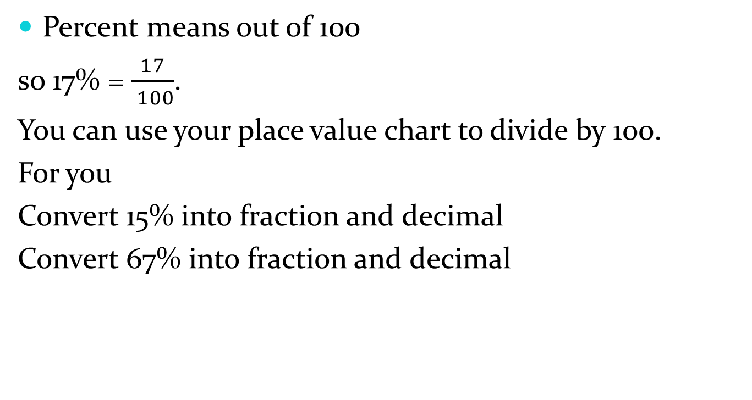
Percentages to fractions to decimals
Percent means out of 100
so 17% = $\frac{17}{ 100}$.
You can use your place value chart to divide by 100.
For you
Convert 15% into fraction and decimal
Convert 67% into fraction and decimal

Slide 3
Decimals to fractions to percentages
Place 0.34 on your place value chart.
What column is the last digit in?

Slide 4
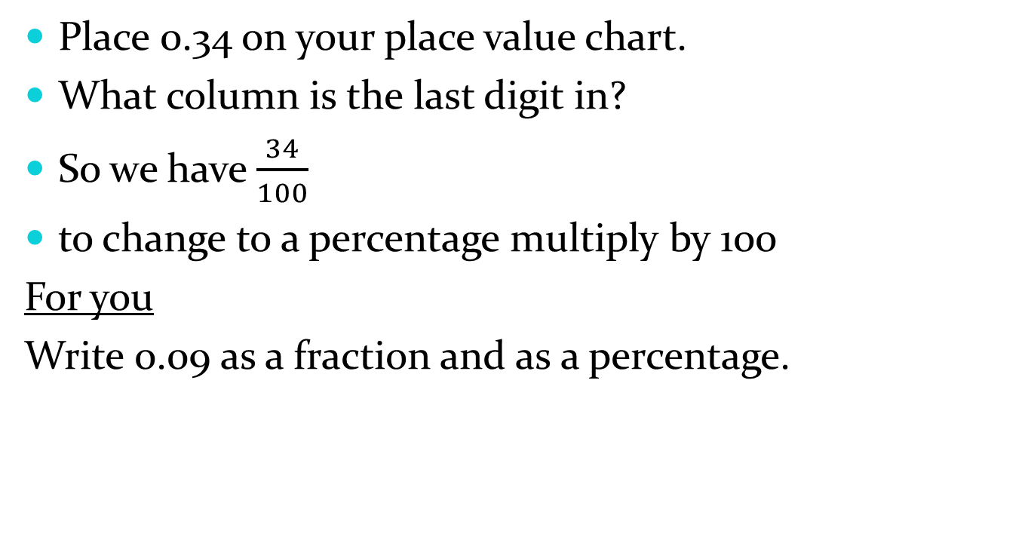
Decimals to fractions to percentages
Place 0.34 on your place value chart.
What column is the last digit in?
So we have $\frac{34}{100}$
to change to a percentage multiply by 100
For you
Write 0.09 as a fraction and as a percentage.

Slide 5

Fractions to decimals to percentages
We need to make all fractions out of 10, 100 or 1000 to be able to convert them.
So $\frac{1}{2}=\frac{}{10}=\frac{}{100}$

Slide 6
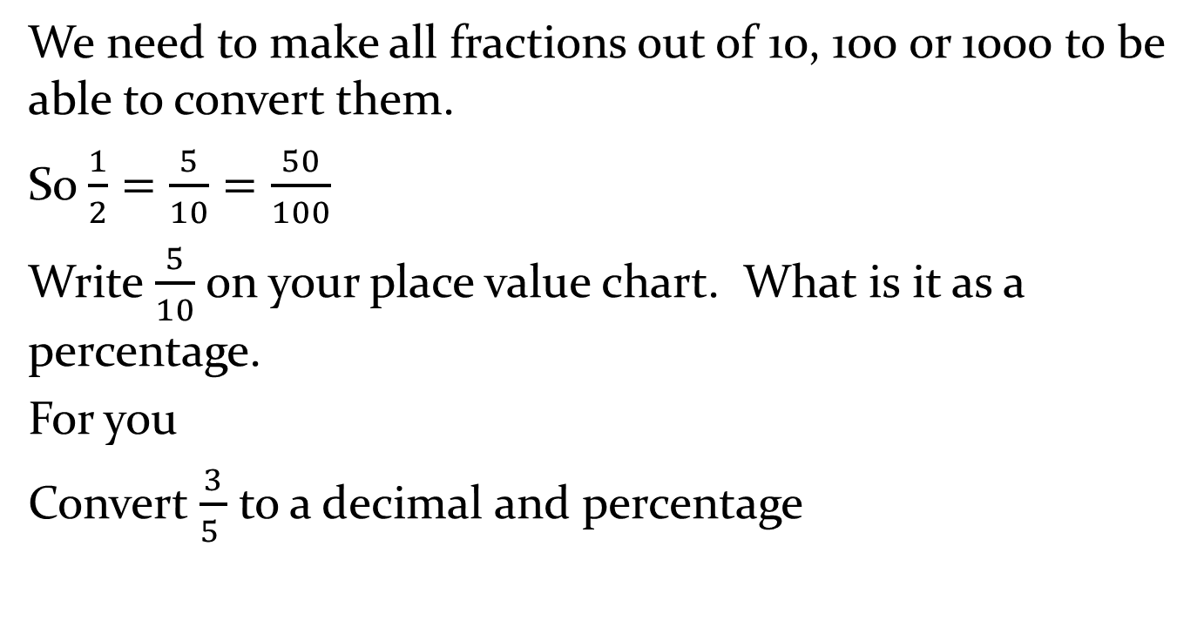
Fractions to decimals to percentages
We need to make all fractions out of 10, 100 or 1000 to be able to convert them.
So $\frac{1}{2}=\frac{5}{10}=\frac{50}{100}$
Write $\frac{5}{10}$ on your place value chart. What is it as a percentage.
For you
Convert $\frac{3}{5 }$ to a decimal and percentage

Slide 7
Complete the conversion chart
Practise time!!

Slide 8
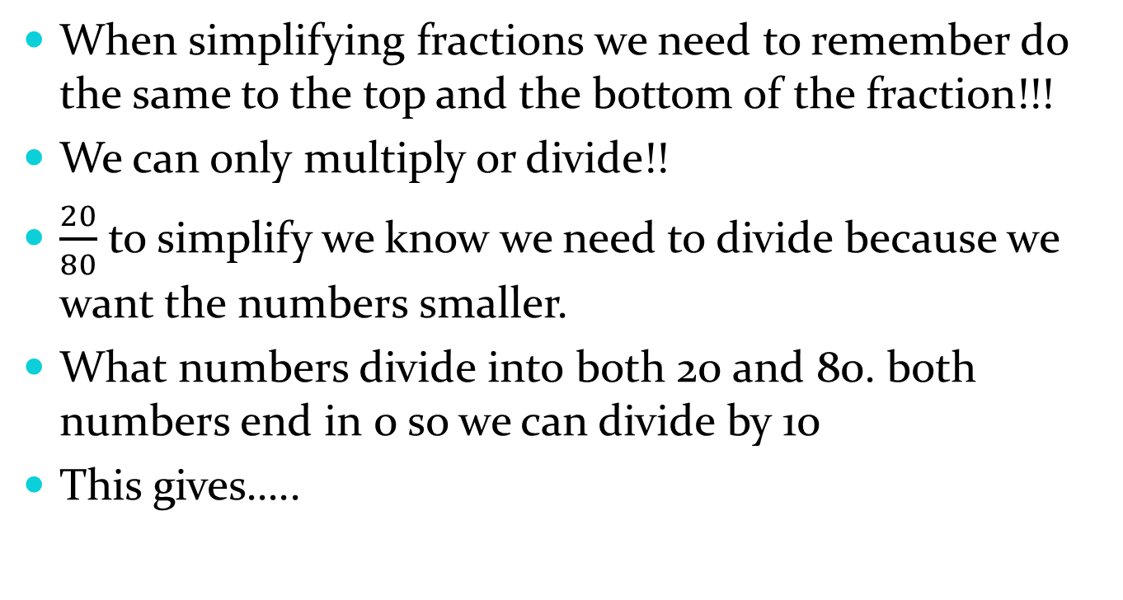
Simplifying fractions
When simplifying fractions we need to remember do the same to the top and the bottom of the fraction!!!
We can only multiply or divide!!
$\frac{20}{80}$ to simplify we know we need to divide because we want the numbers smaller.
What numbers divide into both 20 and 80. both numbers end in 0 so we can divide by 10
This gives…..

Slide 9
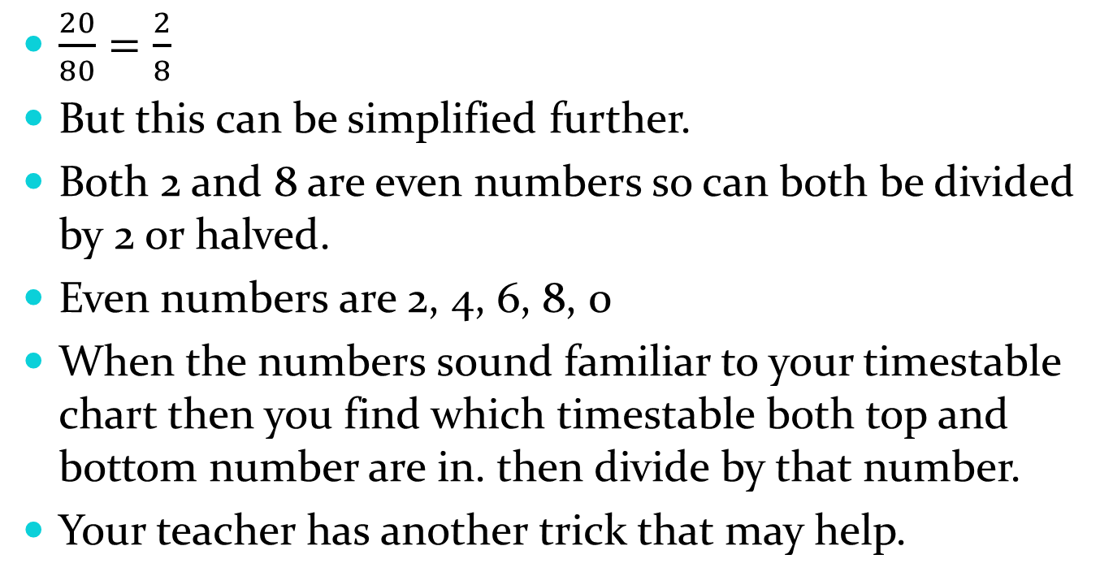
Simplifying fractions
$\frac{20}{80}=\frac{2}{8}$
But this can be simplified further.
Both 2 and 8 are even numbers so can both be divided by 2 or halved.
Even numbers are 2, 4, 6, 8, 0
When the numbers sound familiar to your timestable chart then you find which timestable both top and bottom number are in. then divide by that number.
Your teacher has another trick that may help.

